Slide 1
File Allocation Table (FAT)
The File Allocation Table (FAT) overcomes the drawback of Linked File allocation.
The random access of a particular block is not possible in the linked file allocation. To access a particular block it is necessary to access all its previous blocks.
Let's see how File Allocation Table works.
Explanation
In the file allocation table, all disk block links are collected and maintained. Here the number of head seeks is reduced by caching the file allocation table so that the head does not need to go through all the disk blocks to access one particular block.
The whole process of randomly accessing any block using FAT is completed by reading the desired entry of a block from the file allocation table and accessing that particular block.
The diagrammatic representation of FAT is given below -

Slide 2
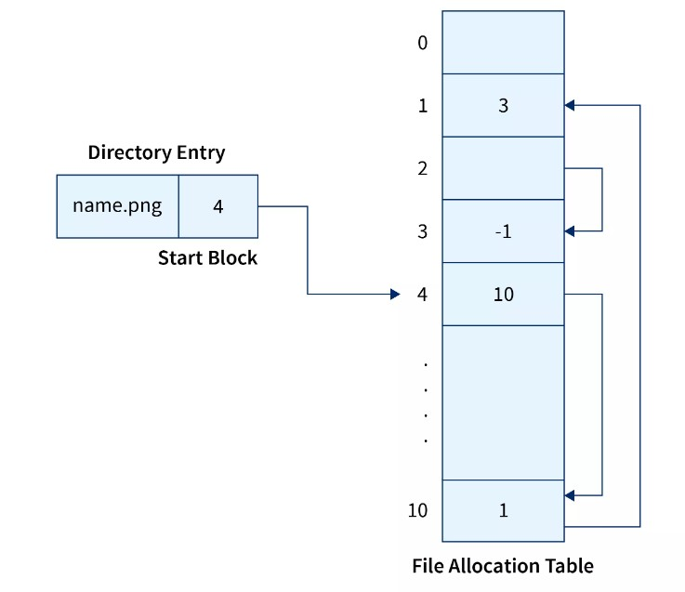

Slide 3
Advantages
Random Access to the block is possible in FAT.
One bad/corrupted disk block cannot corrupt all the other blocks.
It uses all the disk blocks for data as in linked file allocation it needs extra space for pointers.
Disadvantages
If entries increase so the FAT size also increases.
Each entry requires the FAT entry.
If Entries increase the FAT size increases which increases the size of a block so there are chances of internal fragmentation.

Slide 4
Inode.
In Operating systems based on UNIX, every file is indexed using Inode(information-node).
The inode is the special disk block that is created with the creation of the file system.
This special block is used to store all the information related to the file like name, authority, size, etc along with the pointers to the other blocks where the file is stored.

Slide 5
Free space management
It is not easy work for an operating system to allocate and de-allocate memory blocks (managing free space) simultaneously.
The operating system uses various methods for adding free space and freeing up space after deleting a file.
There are various methods using which a free space list can be implemented. We are going to explain them below-

Slide 6
Bitmap or Bit Vector :
A bit vector is the most frequently used method to implement the free space list. A bit vector is also known as a "Bit map".
It is a series or collection of bits in which each bit represents a disk block. The values taken by the bits are either 1 or 0.
If the block bit is 1, it means the block is empty and if the block bit is 0, it means the block is not free.
It is allocated to some files. Since all the blocks are empty initially so, each bit in the bit vector represents 0.

Slide 7
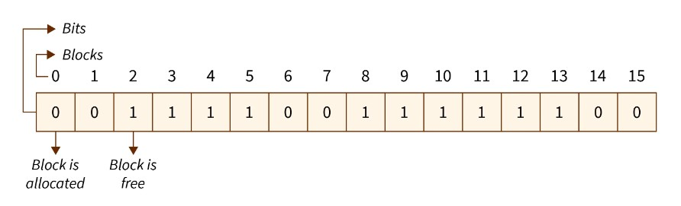
"Free block number" can be defined as that block which does not contain any value, i.e., they are free blocks. The formula to find a free block number is :

Slide 8
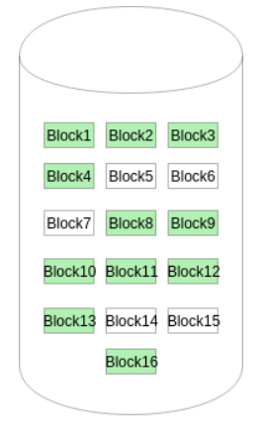
A Bitmap or Bit Vector is series or collection of bits where each bit corresponds to a disk block.
The bit can take two values: 0 and 1: 0 indicates that the block is allocated and 1 indicates a free block.
The given instance of disk blocks on the disk in Figure 1 (where green blocks are allocated) can be represented by a bitmap of 16 bits as: 0000111000000110.

Slide 9
Advantages of Bit vector method :
Simple and easy to understand.
Consumes less memory.
It is efficient to find free space.
Disadvantages of Bit vector method :
The operating system goes through all the blocks until it finds a free block. (block whose bit is 0).
It is not efficient when the disk size is large.

Slide 10
Linked List :
A linked list is another approach for free space management in an operating system.
In it, all the free blocks inside a disk are linked together in a "linked list".
These free blocks on the disk are linked together by a pointer.
These pointers of the free block contain the address of the next free block and the last pointer of the list points to null which indicates the end of the linked list.
This technique is not enough to traverse the list because we have to read each disk block one by one which requires I/O time.

Slide 11
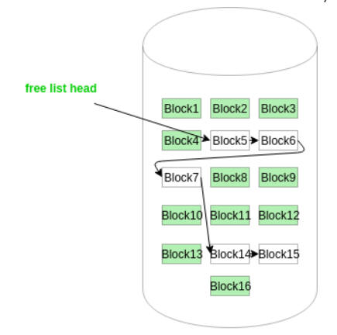

Slide 12
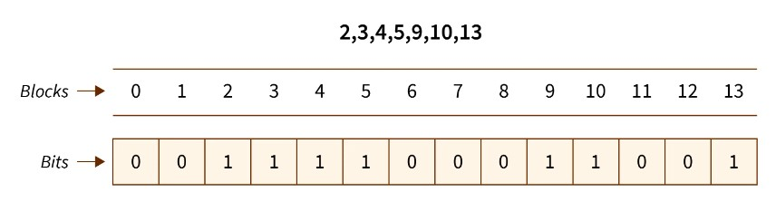
In the above example, block 2 is the first free block and after that block 3 is the next free block, and then block 4 is free. Block 2 contains a pointer that indicates block 3 and blocks 3 contains a pointer that indicates the next free block 4. This continues until the pointer reached the last free block.

Slide 13
Advantage of the Linked list :
In this method, available space is used efficiently.
As there is no size limit on a linked list, a new free space can be added easily.
Disadvantages :
In this method, the overhead of maintaining the pointer appears.
the Linked list is not efficient when we need to reach every block of memory.

Slide 14
Grouping :
The grouping technique is also called the "modification of a linked list technique".
In this method, first, the free block of memory contains the addresses of the n-free blocks.
And the last free block of these n free blocks contains the addresses of the next n free block of memory and this keeps going on.
This technique separates the empty and occupied blocks of space of memory.

Slide 15
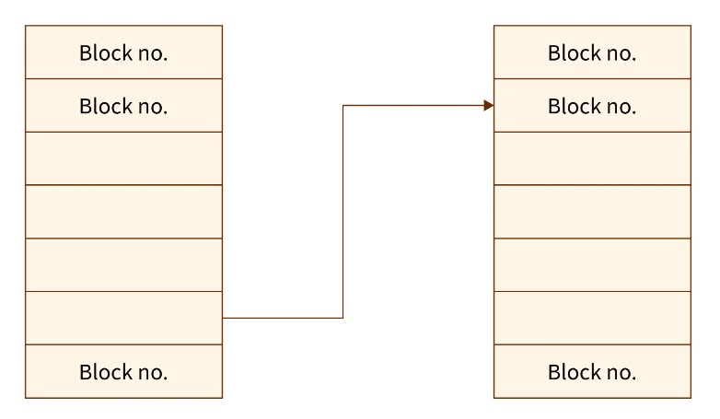

Slide 16
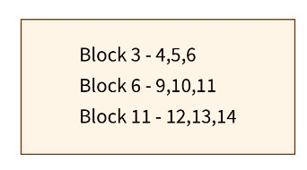
Example :
Suppose we have a disk with some free blocks and some occupied blocks. The free block numbers are 3, 4, 5, 6, 9, 10, 11, 12, 13, and 14. And occupied block numbers are 1, 2, 7, 8, 15 and 16 i.e., they are allocated to some files.

Slide 17
When the "grouping technique" is applied, block 3 will store the addresses of blocks 4, 5, and 6 because 'block 3' is the first free block. In the same way, block 6 will store the addresses of blocks 9, 10, and 11 because block 6 is the first occupied block.
Advantage of the Grouping method :
By using this method, we can easily find addresses of a large number of free blocks easily and quickly.
Disadvantage :
We need to change the entire list if one block gets occupied.

Slide 18
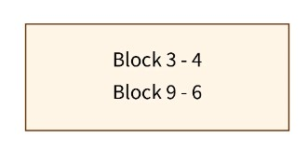
Counting :
In memory space, several files are created and deleted at the same time. For which memory blocks are allocated and de-allocated for the files.
Creation of files occupy free blocks and deletion of file frees blocks. When there is an entry in the free space, it consists of two parameters- "address of first free disk block (a pointer)" and " a number 'n' ".
Example :
Let us take an example where a disk has 16 blocks in which some blocks are empty and some blocks are occupied as given below :

Slide 19
When the "counting technique" is applied, the block number 3 will represent block number 4 because block 3 is the first free block. Then, the block stores the number of free blocks i.e. - there are 4 free blocks together. In the same way, the first occupied block number 9 will represent block number 10 and keeps the number of rest occupied blocks i.e.- there are 6 occupied blocks as shown in the above figure.
Advantages :
In this method, a bunch of free blocks take place fastly.
The list is smaller in size.
Disadvantage :
In the counting method, the first free block stores the rest free blocks, so it requires more space.

